Slide 1
A Neural Network Implementation on the GPU
By Sean M. O’Connell
CSC 7333
Spring 2008

Slide 2
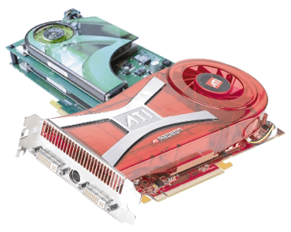
Introduction
Neural Network processing
CPUs vs GPUs
Modern GPU parallelization
Applying GPU architecture to NN
  Exploiting parallel NN node computations
  Mappings to GPU

Slide 3
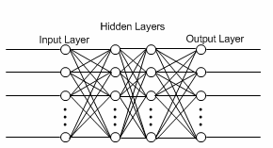
NN Implementation Details
Each layer fully connected to next one
Step activation function
Back-propagation

Slide 4
GPU Architecture
Very different from CPU
Memory layout
  Textures
  Vertex arrays
  Matrices
Devise a new GPU framework / arch.

Slide 5
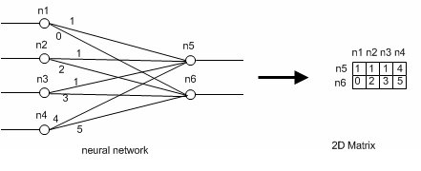
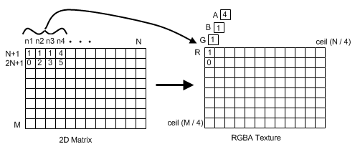
Node Weights

Slide 6
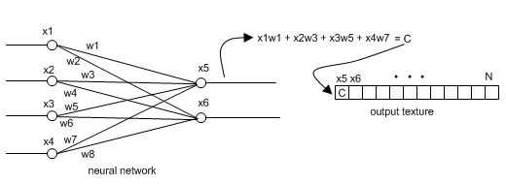
Node Output
Node input uses previous layer’s output

Slide 7
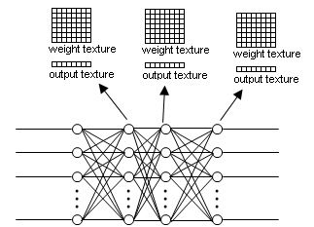
Neural Network Layers
Back-propagation error data stored in ‘error’ texture

Slide 8
Implementation Details
OpenGL 2.0
Pixels plotted to screen
GLSL pixel shaders
Frame Buffer Objects
Vertex Buffer Objects

Slide 9
Pseudo Code
TrainGPUNeuralNetwork(input) Copy training input to input layer’s output texture Run input through network Bind FeedForward pixel shader and associated parameters For each layer in network except input layer Set layer.outputTexture as rendering target Bind layer.weightsTexture Bind previousLayer.outputTexture Render node (x, y) points to the screen for pixel shader processing Copy output to layer.outputTexture Calculate errors for output layer Bind CalcErrors pixel shader and associated parameters Bind outputLayer.errorTexture as rendering target Bind outputLayer.outputTexture Bind expectedOutputTexture Render node (x, y) points to the screen for pixel shader processing Copy output to outputLayer.errorTexture | Backpropagate results to hidden layers Bind Backpropagate pixel shader and associated parameters For each hidden layer in network Set layer.errorTexture as rendering target Bind nextLayer.weightsTexture Bind nextLayer.errorTexture Bind layer.outputTexture Render node (x, y) points to the screen for pixel shader processing Copy output to layer.errorTexture Update weights Bind UpdateWeights pixel shader and associated parameters For each layer in network except input layer Set layer.weightsTexture as rendering target Bind layer.weightsTexture Bind layer.errorTexture Bind layer.outputTexture Render node(x, y) points to the screen for each weight value in layer.weightsTexture for pixel shader processing Copy output to layer.weightsTexture

Slide 10
Test Hardware
Intel Core Duo 2.2Ghz
2GB DDR600 RAM
Nvidia Geforce 7900GTX 512MB

Slide 11
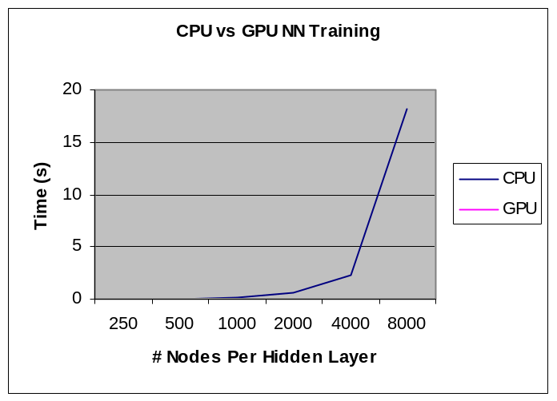
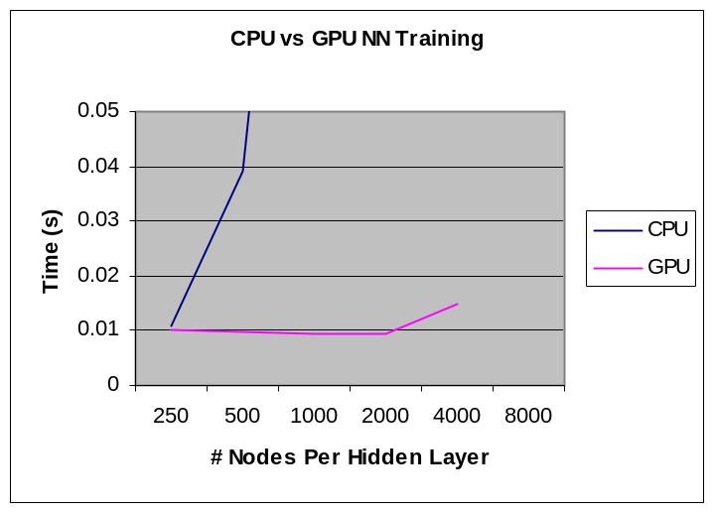
Results
# Nodes / HL | Trial 1 (s) | Trial 2 (s) | Trial 3 (s) | Average Time (s)
250 | 0.013368 | 0.009753 | 0.009765 | 0.010962
500 | 0.038946 | 0.038718 | 0.039813 | 0.039159
1000 | 0.158222 | 0.162031 | 0.166722 | 0.162325
2000 | 0.649959 | 0.627794 | 0.612034 | 0.629929
4000 | 2.352296 | 2.331196 | 2.341666 | 2.341719
8000 | 18.3456 | 18.0687 | 18.55736 | 18.20869
# Nodes / HL | Trial 1 (s) | Trial 2 (s) | Trial 3 (s) | Average Time (s)
250 | 0.008848 | 0.014108 | 0.010849 | 0.009996
500 | 0.012363 | 0.008219 | 0.010619 | 0.009714
1000 | 0.010938 | 0.008703 | 0.00893 | 0.009451
2000 | 0.009136 | 0.009057 | 0.00873 | 0.009332
4000 | 0.008744 | 0.010662 | 0.009173 | 0.014823
GPU Neural Network Training
CPU Neural Network Training

Slide 12
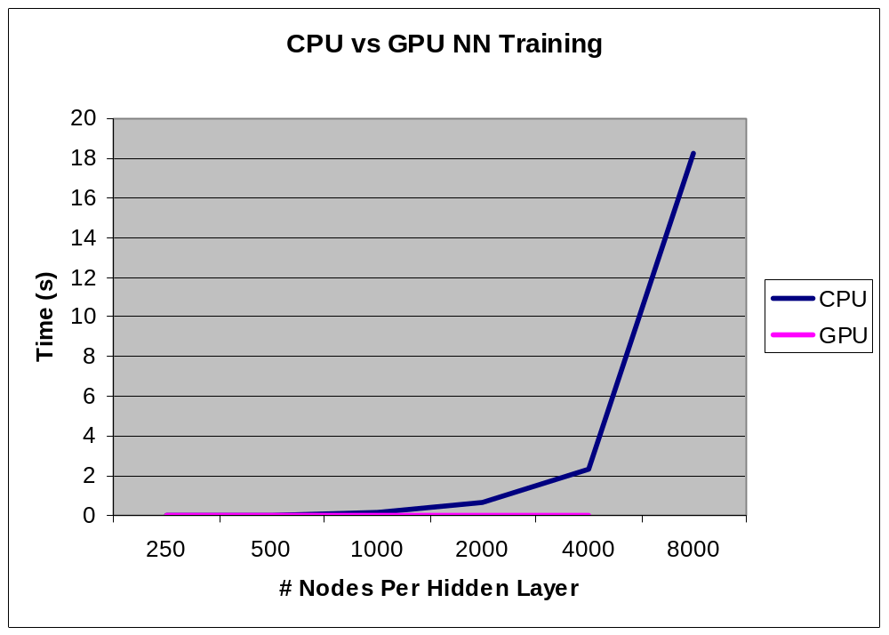
Results

Slide 13
Conclusion
GPU 157x FASTER for 4000 nodes
Lots of improvements can be made
GPU well suited for A.I.

Slide 14
Questions?
References
[1] Machine Learning. Tom M. Mitchell. The McGraw Hill Companies, 1997.
[2] OpenGL – The Industry Standard for High Performance Graphics.
http://www.opengl.org

